Slide 1
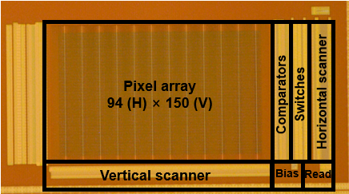
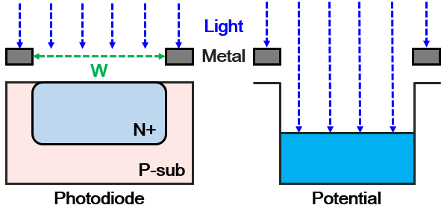
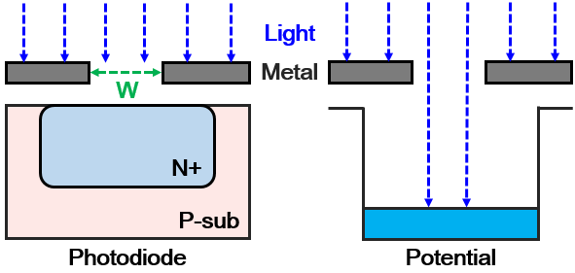
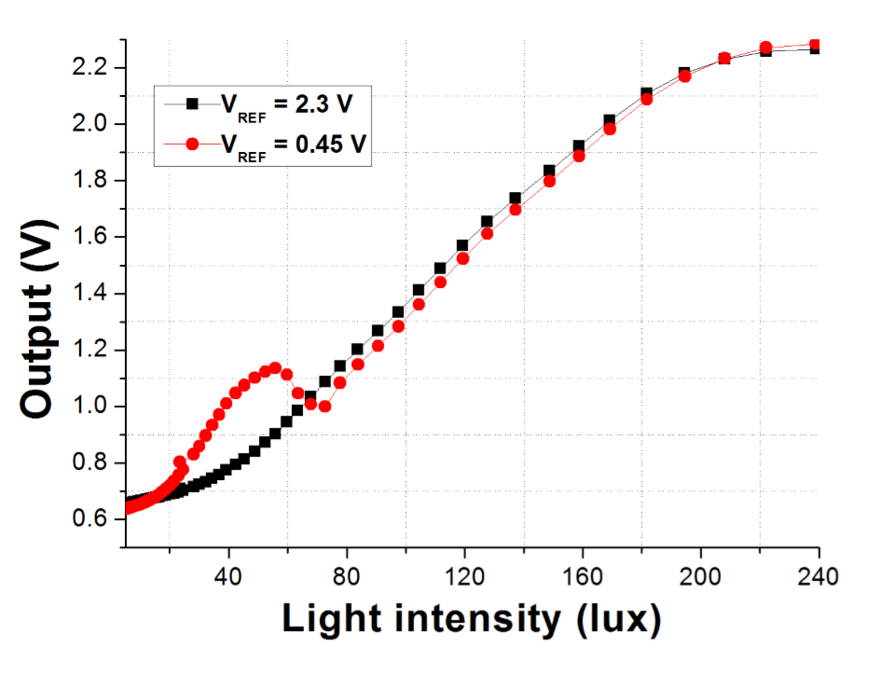
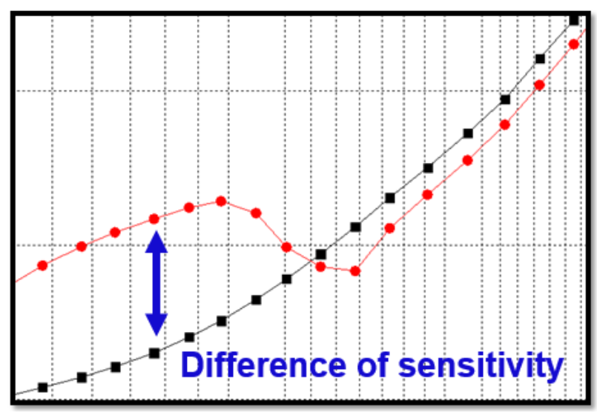
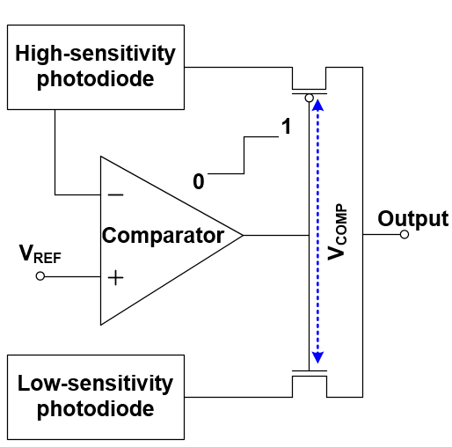
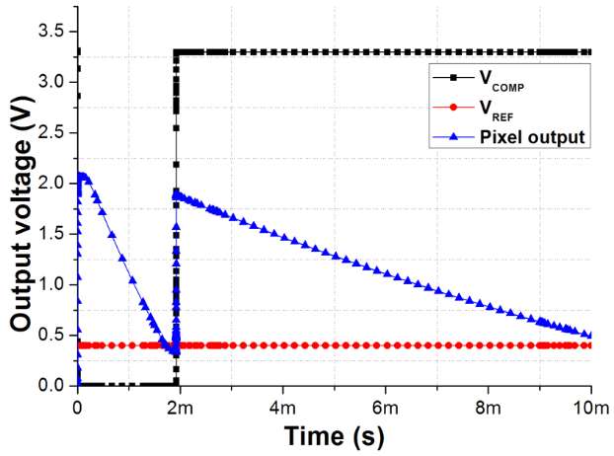
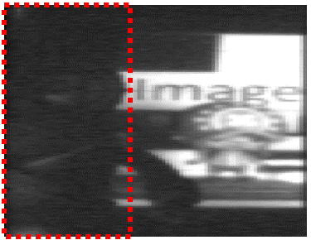
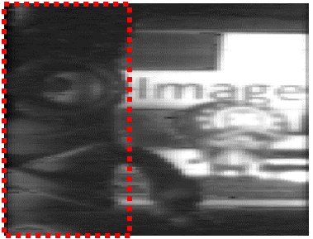
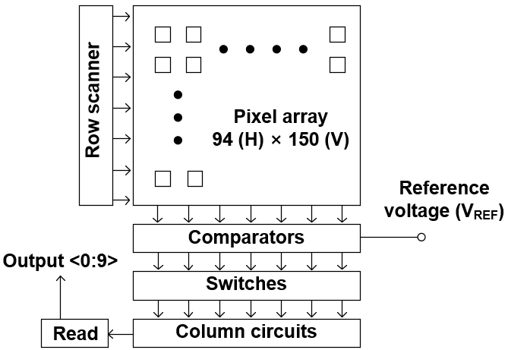
A Wide-Dynamic-Range CMOS Image Sensor based on sensitivity-variable-type using Dual photodiode
Jimin Lee¹ and Jang-Kyoo Shin*
Department of Electronic Engineering, Kyungpook National University
E-mail : *jkshin@ee.knu.ac.kr
Concept of the proposed CIS
Experiment results
● Different sensitivities using a metal shielding technique
(a)
(b)
Fig. 1 (a) and (b) show the sensitivity and the amount of light according to width of the metal shielding hole.
Fig. 4 Chip image of the proposed CIS.
- In the conventional CMOS process, microlens is not generally integrated. Therefore, whole area of the photodiode is illuminated by the amount of light without light collection.
- Sensitivity is affected by the amount of light on the photodiode region, which reduces the amount of light using metal shielding technique to reduce sensitivity.
● Comparator and switches
(a)
(b)
Fig. 5 (a) Experiment results of the proposed CIS depending on the V_{REF} and (b) difference of the sensitivity depending on the V_{REF} at low
light condition.
(a)
(b)
Fig. 2 (a) Schematic of the switching circuit and two photodiodes with different sensitivity, and (b) expected operation of the pixel output voltage with the comparator output and the reference voltage.
- The comparator and switches are the core of the proposed structure that output changes from the high- to the low-sensitivity photodiode before the high-sensitivity photodiode is saturated.
(a)
(b)
Fig. 6 Image of the proposed CIS when V_{REF} is (a) 2.3 V, and (b) 0.45 V.
Conclusions
- The proposed CIS has an advantage to selectively use between the output of high-sensitivity photodiode and low-sensitivity photodiode depending on the illumination condition with controlling V_{REF}.
- The proposed CIS has a higher processing speed without complex digital signal processing (DSP) circuit.
Fig. 3 Block diagram of the proposed CIS.
- It is confirmed that dynamic range of the proposed CIS is extended compared to the conventional CIS.

